Slide 1
Probing the Dynamics of Methane in Metal-Organic Frameworks by Disk Chopper Spectrometer
Kai Gong, Tommy Harrelson, Ben Paren, Matthew Krafcik, Zhixia Li, Xiao Hu, Shuonan Chen
Group 3:
NCNR Neutron Scattering Workshop | June 19-23, 2017
Notes:
Good morning, professors. Today I will walk you through my thesis proposal on “The influence of sulfate attack on atomic structure and transport properties of alkali-activated materials”.

Slide 2
Outline
1. Background
Methane storage in metal-organic frameworks
Why do we need to study the methane dynamics?
2. Materials & Methods
How DCS works?
Why DCS?
3. Preliminary Results
Case 1: MOF-5 (rotational tunnelling modes, phonon density of states)
Case II: UiO-66 (rotational tunneling modes)
4. Conclusions
Title: Probing the Dynamics of Methane in Metal-Organic Frameworks by Disk Chopper Spectrometer
Notes:
Here is the outline of my presentation. I will start with some background information, like environmental impact of OPC and environmental benefits developing AAMs; what are sulfate attack and why do we care about sulfate attack of AAMs.
I will then talk about the research gaps identified based on the current literature on sulfate attack of AAMs. Based on the research gap, I have raised a number of research questions I hope to answer and a number of objectives I hope to achieve during my phd.
In order to answer these questions and achieve these objectives, I have outlined 7 tasks to be undertaken, which can be grouped into two parts. The first part consisting of task 1-3 is focused on the atomic structure and transport properties of neat AAMs, The second part consisting of tasks 4-7 will be focusing on the influence of sulfate attack on the atomic structure and transport properties of neat AAMs. Finally, I will briefly talk about the research schedule proposed to undertake these tasks.
The first part which consists of 3 tasks are the focus of the first two years of my phd, while my next three years will be focusing on the second part. The purpose of the first part on neat AAMs are three fold: (1) to get farmilarize with the AAMs materials, (2) experimental and simulation methods that will be used for studies in the second part, and (3) to be used as control for part 2.
Finally, I will quickly go through the proposed research schedule.

Slide 3
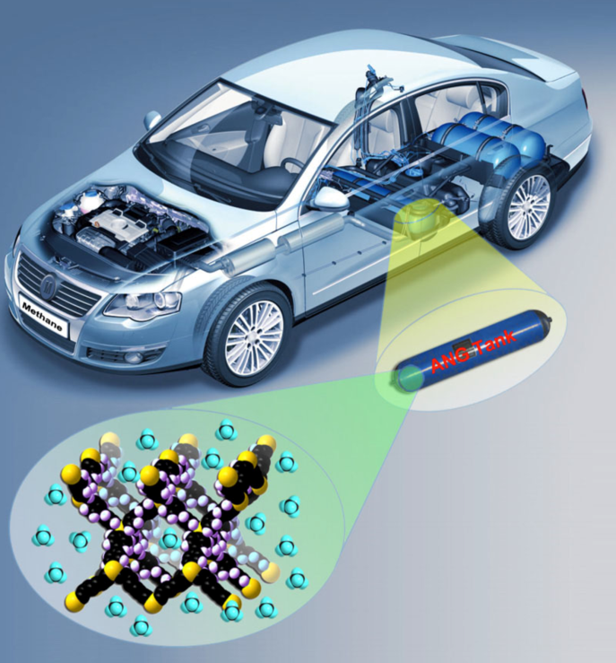
Background
Materials & Method
Preliminary Results
Conclusions
Methane storage in porous metal-organic framework
Methane (CH₄) is a clean and naturally abundant source of energy
Storing methane in porous media is actively pursued due to its high volumetric energy density
Metal-organic framework is attractive due to:
Highly crystalline structure
Nanometer-sized pores
Ultrahigh porosities
Functionalizable pore walls
How strongly methane interact with the porous framework is critical
Too weak
Too strong
Difficult to adsorb
Difficult to desorb
Title: Probing the Dynamics of Methane in Metal-Organic Frameworks by Disk Chopper Spectrometer
Notes:
SO42-: 2-3mg/L, Mg 700 mg/L; Na 11mg/L
One durability issue AAM may face as a building material is sulfate attack, since sulfate attack is a major durability issue for OPC concrete structures. For the OPC-based materials, sulfate attack occurs when sulfate-bearing chemicals penetrate into the material through the porous network and react with the chemical phases in OPC, leading to severe damage to the material. Under sulfate attack, four major degradation reactions may occur. Two of them involves the sulfate ions taking out Ca, Al from the different chemical phases in OPC to form expansive gypsum and ettringite, which can cause the material to crack. When exposed to MgSO4, the Mg ions may transform the C-S-H gel to a M-S-H gel which has lower cohesive strength. Also, under sulfate attack, especially for MgSO4 and H2SO4, the ph of the system will decrease. The decrease of ph can not only destabilize the chemical phases in OPC but also accelerate the corrosion of steel rebar embedded.
Due to these degradation actions, sulfate attack can cause severe damage to concrete structures. The risk of sulfate attack is real for concrete structure in coastal area since seawater is abundant with Na2SO4 and MgSO4. In places where sulfate bearing soils are presented, sulfate-bearing chemicals can be dissolved in groundwater and cause severe damage to the concrete foundations.
In AAMs, there are also abundant Al and Ca, a nature question one may ask is how does the Al and Ca-containing phases in AAM would interact with these sulfate-bearing chemicals and how does these interaction impact the durability of AAMs. In my phd, I hope to contribute to answering these questions.
Q: how cracks are formed? Crystallization pressure.
Concentration of sulfate ions in sea water and ground water

Slide 4
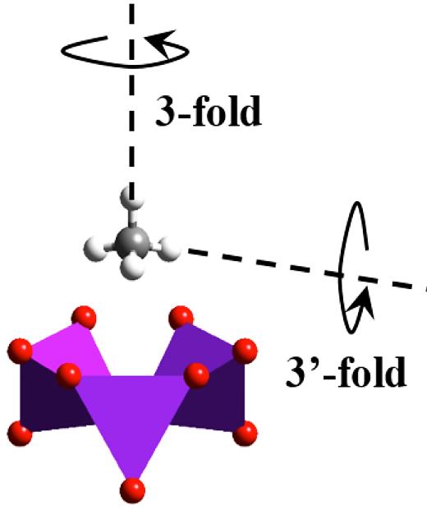
Background
Materials & Method
Preliminary Results
Conclusions
Methane dynamics in metal-organic framework
At high temperature, rotational diffusion dominates
At low temperature, motions such as rotational tunneling dominate
Dynamics of methane in the metal-organic framework → the interaction between methane and the metal organic framework
Title: Probing the Dynamics of Methane in Metal-Organic Frameworks by Disk Chopper Spectrometer
Notes:
SO42-: 2-3mg/L, Mg 700 mg/L; Na 11mg/L
One durability issue AAM may face as a building material is sulfate attack, since sulfate attack is a major durability issue for OPC concrete structures. For the OPC-based materials, sulfate attack occurs when sulfate-bearing chemicals penetrate into the material through the porous network and react with the chemical phases in OPC, leading to severe damage to the material. Under sulfate attack, four major degradation reactions may occur. Two of them involves the sulfate ions taking out Ca, Al from the different chemical phases in OPC to form expansive gypsum and ettringite, which can cause the material to crack. When exposed to MgSO4, the Mg ions may transform the C-S-H gel to a M-S-H gel which has lower cohesive strength. Also, under sulfate attack, especially for MgSO4 and H2SO4, the ph of the system will decrease. The decrease of ph can not only destabilize the chemical phases in OPC but also accelerate the corrosion of steel rebar embedded.
Due to these degradation actions, sulfate attack can cause severe damage to concrete structures. The risk of sulfate attack is real for concrete structure in coastal area since seawater is abundant with Na2SO4 and MgSO4. In places where sulfate bearing soils are presented, sulfate-bearing chemicals can be dissolved in groundwater and cause severe damage to the concrete foundations.
In AAMs, there are also abundant Al and Ca, a nature question one may ask is how does the Al and Ca-containing phases in AAM would interact with these sulfate-bearing chemicals and how does these interaction impact the durability of AAMs. In my phd, I hope to contribute to answering these questions.
Q: how cracks are formed? Crystallization pressure.
Concentration of sulfate ions in sea water and ground water

Slide 5
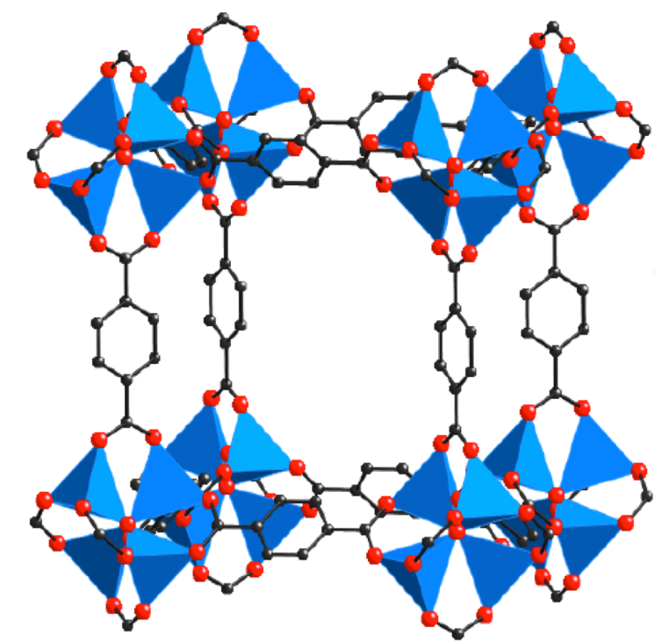
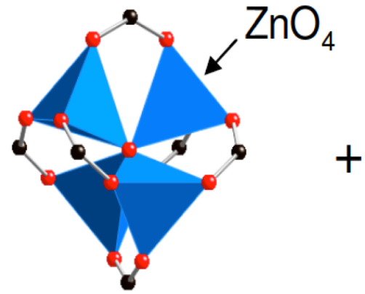
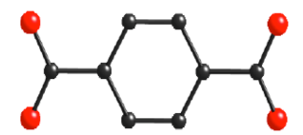
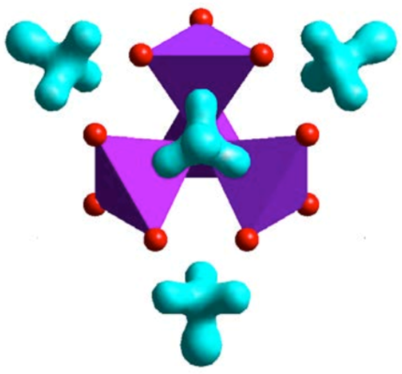
Background
Materials & Method
Preliminary Results
Conclusions
Case 1: MOF-5
Metal connector
Organic linker
MOF-5 crystal unit cell
Location of CH4 adsorption in MOF-5
Title: Probing the Dynamics of Methane in Metal-Organic Frameworks by Disk Chopper Spectrometer
Notes:
SO42-: 2-3mg/L, Mg 700 mg/L; Na 11mg/L
One durability issue AAM may face as a building material is sulfate attack, since sulfate attack is a major durability issue for OPC concrete structures. For the OPC-based materials, sulfate attack occurs when sulfate-bearing chemicals penetrate into the material through the porous network and react with the chemical phases in OPC, leading to severe damage to the material. Under sulfate attack, four major degradation reactions may occur. Two of them involves the sulfate ions taking out Ca, Al from the different chemical phases in OPC to form expansive gypsum and ettringite, which can cause the material to crack. When exposed to MgSO4, the Mg ions may transform the C-S-H gel to a M-S-H gel which has lower cohesive strength. Also, under sulfate attack, especially for MgSO4 and H2SO4, the ph of the system will decrease. The decrease of ph can not only destabilize the chemical phases in OPC but also accelerate the corrosion of steel rebar embedded.
Due to these degradation actions, sulfate attack can cause severe damage to concrete structures. The risk of sulfate attack is real for concrete structure in coastal area since seawater is abundant with Na2SO4 and MgSO4. In places where sulfate bearing soils are presented, sulfate-bearing chemicals can be dissolved in groundwater and cause severe damage to the concrete foundations.
In AAMs, there are also abundant Al and Ca, a nature question one may ask is how does the Al and Ca-containing phases in AAM would interact with these sulfate-bearing chemicals and how does these interaction impact the durability of AAMs. In my phd, I hope to contribute to answering these questions.
Q: how cracks are formed? Crystallization pressure.
Concentration of sulfate ions in sea water and ground water

Slide 6
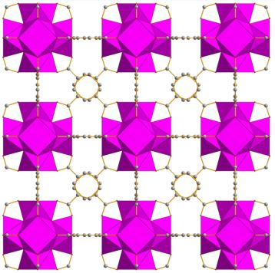
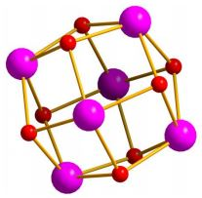
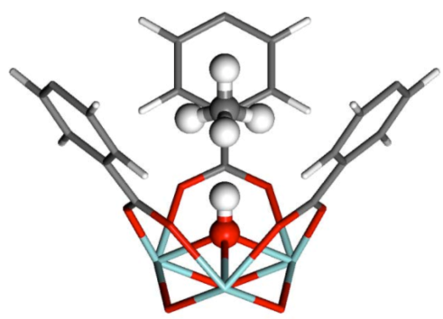
Background
Materials & Method
Preliminary Results
Conclusions
Case II: UiO-66
Metal connector
Organic linker
UiO-66 crystal unit cell
Zr₆O₄(OH)₄
Cavka et al. J. Am. Chem. Soc. 2008
Location of CH₄ adsorption in UiO-66
Title: Probing the Dynamics of Methane in Metal-Organic Frameworks by Disk Chopper Spectrometer
Notes:
SO42-: 2-3mg/L, Mg 700 mg/L; Na 11mg/L
One durability issue AAM may face as a building material is sulfate attack, since sulfate attack is a major durability issue for OPC concrete structures. For the OPC-based materials, sulfate attack occurs when sulfate-bearing chemicals penetrate into the material through the porous network and react with the chemical phases in OPC, leading to severe damage to the material. Under sulfate attack, four major degradation reactions may occur. Two of them involves the sulfate ions taking out Ca, Al from the different chemical phases in OPC to form expansive gypsum and ettringite, which can cause the material to crack. When exposed to MgSO4, the Mg ions may transform the C-S-H gel to a M-S-H gel which has lower cohesive strength. Also, under sulfate attack, especially for MgSO4 and H2SO4, the ph of the system will decrease. The decrease of ph can not only destabilize the chemical phases in OPC but also accelerate the corrosion of steel rebar embedded.
Due to these degradation actions, sulfate attack can cause severe damage to concrete structures. The risk of sulfate attack is real for concrete structure in coastal area since seawater is abundant with Na2SO4 and MgSO4. In places where sulfate bearing soils are presented, sulfate-bearing chemicals can be dissolved in groundwater and cause severe damage to the concrete foundations.
In AAMs, there are also abundant Al and Ca, a nature question one may ask is how does the Al and Ca-containing phases in AAM would interact with these sulfate-bearing chemicals and how does these interaction impact the durability of AAMs. In my phd, I hope to contribute to answering these questions.
Q: how cracks are formed? Crystallization pressure.
Concentration of sulfate ions in sea water and ground water

Slide 7
Background
Materials & Method
Preliminary Results
Conclusions
Disc Chopper Spectrometer: schematic view
Title: Probing the Dynamics of Methane in Metal-Organic Frameworks by Disk Chopper Spectrometer
Notes:
SO42-: 2-3mg/L, Mg 700 mg/L; Na 11mg/L
One durability issue AAM may face as a building material is sulfate attack, since sulfate attack is a major durability issue for OPC concrete structures. For the OPC-based materials, sulfate attack occurs when sulfate-bearing chemicals penetrate into the material through the porous network and react with the chemical phases in OPC, leading to severe damage to the material. Under sulfate attack, four major degradation reactions may occur. Two of them involves the sulfate ions taking out Ca, Al from the different chemical phases in OPC to form expansive gypsum and ettringite, which can cause the material to crack. When exposed to MgSO4, the Mg ions may transform the C-S-H gel to a M-S-H gel which has lower cohesive strength. Also, under sulfate attack, especially for MgSO4 and H2SO4, the ph of the system will decrease. The decrease of ph can not only destabilize the chemical phases in OPC but also accelerate the corrosion of steel rebar embedded.
Due to these degradation actions, sulfate attack can cause severe damage to concrete structures. The risk of sulfate attack is real for concrete structure in coastal area since seawater is abundant with Na2SO4 and MgSO4. In places where sulfate bearing soils are presented, sulfate-bearing chemicals can be dissolved in groundwater and cause severe damage to the concrete foundations.
In AAMs, there are also abundant Al and Ca, a nature question one may ask is how does the Al and Ca-containing phases in AAM would interact with these sulfate-bearing chemicals and how does these interaction impact the durability of AAMs. In my phd, I hope to contribute to answering these questions.
Q: how cracks are formed? Crystallization pressure.
Concentration of sulfate ions in sea water and ground water

Slide 8
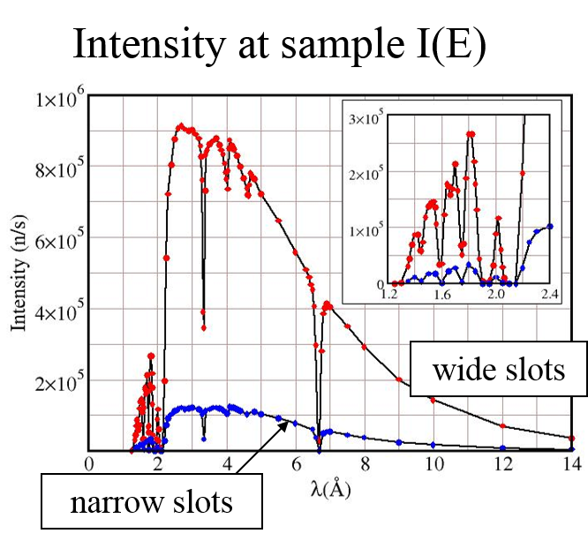
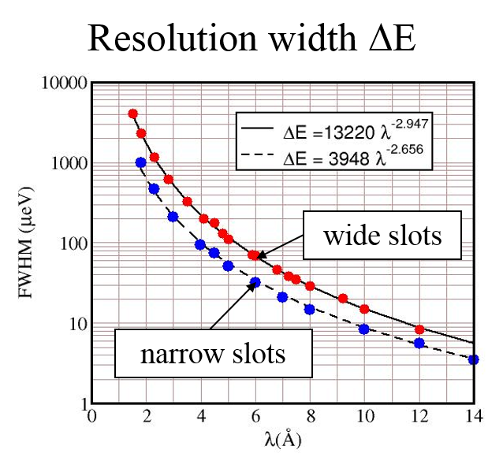
Background
Materials & Method
Preliminary Results
Conclusions
Why DCS?
25meV
1meV
Intensity
Resolution
Title: Probing the Dynamics of Methane in Metal-Organic Frameworks by Disk Chopper Spectrometer
Notes:
SO42-: 2-3mg/L, Mg 700 mg/L; Na 11mg/L
One durability issue AAM may face as a building material is sulfate attack, since sulfate attack is a major durability issue for OPC concrete structures. For the OPC-based materials, sulfate attack occurs when sulfate-bearing chemicals penetrate into the material through the porous network and react with the chemical phases in OPC, leading to severe damage to the material. Under sulfate attack, four major degradation reactions may occur. Two of them involves the sulfate ions taking out Ca, Al from the different chemical phases in OPC to form expansive gypsum and ettringite, which can cause the material to crack. When exposed to MgSO4, the Mg ions may transform the C-S-H gel to a M-S-H gel which has lower cohesive strength. Also, under sulfate attack, especially for MgSO4 and H2SO4, the ph of the system will decrease. The decrease of ph can not only destabilize the chemical phases in OPC but also accelerate the corrosion of steel rebar embedded.
Due to these degradation actions, sulfate attack can cause severe damage to concrete structures. The risk of sulfate attack is real for concrete structure in coastal area since seawater is abundant with Na2SO4 and MgSO4. In places where sulfate bearing soils are presented, sulfate-bearing chemicals can be dissolved in groundwater and cause severe damage to the concrete foundations.
In AAMs, there are also abundant Al and Ca, a nature question one may ask is how does the Al and Ca-containing phases in AAM would interact with these sulfate-bearing chemicals and how does these interaction impact the durability of AAMs. In my phd, I hope to contribute to answering these questions.
Q: how cracks are formed? Crystallization pressure.
Concentration of sulfate ions in sea water and ground water

Slide 9
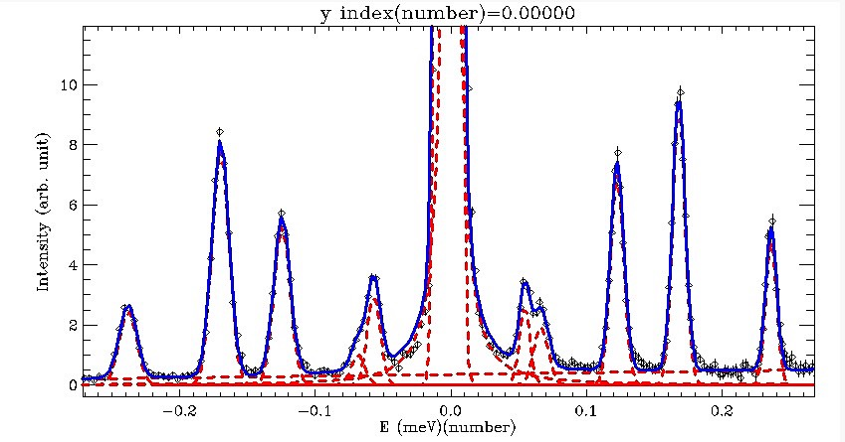
Background
Materials & Method
Preliminary Results
Conclusions
Case 1: MOF-5 CH₄ rotational tunnelling modes
Measurement conditions: 1.5 K, 9 $Å$ (~1meV)
Fitted with 5 Gaussians on each side of the elastic peak→ 5 transitions between energy levels
Title: Probing the Dynamics of Methane in Metal-Organic Frameworks by Disk Chopper Spectrometer
Notes:
SO42-: 2-3mg/L, Mg 700 mg/L; Na 11mg/L
One durability issue AAM may face as a building material is sulfate attack, since sulfate attack is a major durability issue for OPC concrete structures. For the OPC-based materials, sulfate attack occurs when sulfate-bearing chemicals penetrate into the material through the porous network and react with the chemical phases in OPC, leading to severe damage to the material. Under sulfate attack, four major degradation reactions may occur. Two of them involves the sulfate ions taking out Ca, Al from the different chemical phases in OPC to form expansive gypsum and ettringite, which can cause the material to crack. When exposed to MgSO4, the Mg ions may transform the C-S-H gel to a M-S-H gel which has lower cohesive strength. Also, under sulfate attack, especially for MgSO4 and H2SO4, the ph of the system will decrease. The decrease of ph can not only destabilize the chemical phases in OPC but also accelerate the corrosion of steel rebar embedded.
Due to these degradation actions, sulfate attack can cause severe damage to concrete structures. The risk of sulfate attack is real for concrete structure in coastal area since seawater is abundant with Na2SO4 and MgSO4. In places where sulfate bearing soils are presented, sulfate-bearing chemicals can be dissolved in groundwater and cause severe damage to the concrete foundations.
In AAMs, there are also abundant Al and Ca, a nature question one may ask is how does the Al and Ca-containing phases in AAM would interact with these sulfate-bearing chemicals and how does these interaction impact the durability of AAMs. In my phd, I hope to contribute to answering these questions.
Q: how cracks are formed? Crystallization pressure.
Concentration of sulfate ions in sea water and ground water

Slide 10
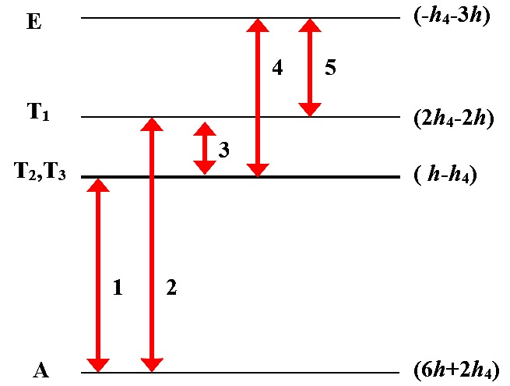
Background
Materials & Method
Preliminary Results
Conclusions
Case 1: MOF-5 CH₄ rotational tunnelling modes
2
1
4
5
3
h= -30.27µeV; h₄= -7.83µeV
Transition energy is used to calculate the barrier energy V_{barrier} = 23 meV; V_{barrier2} = 17.2 meV
Energy barrier calculated from DFT-D: V_{DFT} = 46 meV; V_{DFT2} = 28 meV
Title: Probing the Dynamics of Methane in Metal-Organic Frameworks by Disk Chopper Spectrometer
Notes:
SO42-: 2-3mg/L, Mg 700 mg/L; Na 11mg/L
One durability issue AAM may face as a building material is sulfate attack, since sulfate attack is a major durability issue for OPC concrete structures. For the OPC-based materials, sulfate attack occurs when sulfate-bearing chemicals penetrate into the material through the porous network and react with the chemical phases in OPC, leading to severe damage to the material. Under sulfate attack, four major degradation reactions may occur. Two of them involves the sulfate ions taking out Ca, Al from the different chemical phases in OPC to form expansive gypsum and ettringite, which can cause the material to crack. When exposed to MgSO4, the Mg ions may transform the C-S-H gel to a M-S-H gel which has lower cohesive strength. Also, under sulfate attack, especially for MgSO4 and H2SO4, the ph of the system will decrease. The decrease of ph can not only destabilize the chemical phases in OPC but also accelerate the corrosion of steel rebar embedded.
Due to these degradation actions, sulfate attack can cause severe damage to concrete structures. The risk of sulfate attack is real for concrete structure in coastal area since seawater is abundant with Na2SO4 and MgSO4. In places where sulfate bearing soils are presented, sulfate-bearing chemicals can be dissolved in groundwater and cause severe damage to the concrete foundations.
In AAMs, there are also abundant Al and Ca, a nature question one may ask is how does the Al and Ca-containing phases in AAM would interact with these sulfate-bearing chemicals and how does these interaction impact the durability of AAMs. In my phd, I hope to contribute to answering these questions.
Q: how cracks are formed? Crystallization pressure.
Concentration of sulfate ions in sea water and ground water

Slide 11
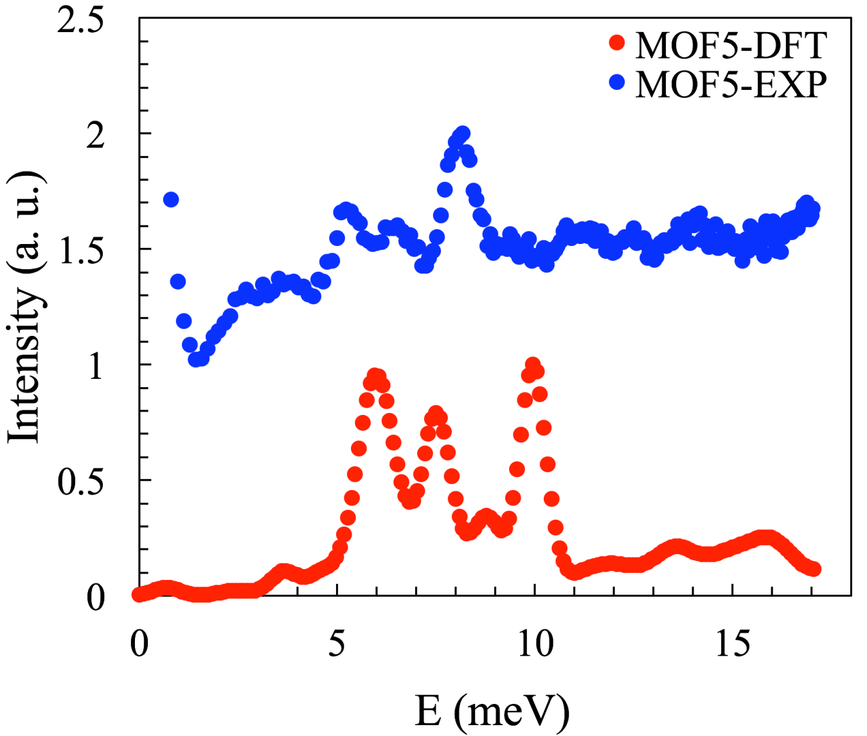
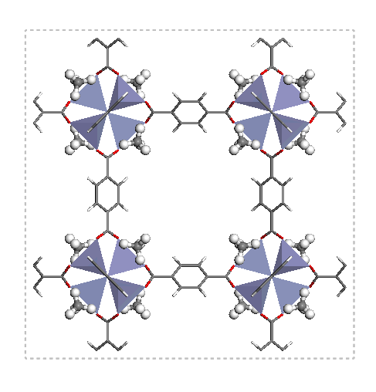
Background
Materials & Method
Preliminary Results
Conclusions
Case 1: MOF-5 CH4 phonon density of states
Experiment vs DFT calculation
1.81A 25meV
Title: Probing the Dynamics of Methane in Metal-Organic Frameworks by Disk Chopper Spectrometer
Notes:
SO42-: 2-3mg/L, Mg 700 mg/L; Na 11mg/L
One durability issue AAM may face as a building material is sulfate attack, since sulfate attack is a major durability issue for OPC concrete structures. For the OPC-based materials, sulfate attack occurs when sulfate-bearing chemicals penetrate into the material through the porous network and react with the chemical phases in OPC, leading to severe damage to the material. Under sulfate attack, four major degradation reactions may occur. Two of them involves the sulfate ions taking out Ca, Al from the different chemical phases in OPC to form expansive gypsum and ettringite, which can cause the material to crack. When exposed to MgSO4, the Mg ions may transform the C-S-H gel to a M-S-H gel which has lower cohesive strength. Also, under sulfate attack, especially for MgSO4 and H2SO4, the ph of the system will decrease. The decrease of ph can not only destabilize the chemical phases in OPC but also accelerate the corrosion of steel rebar embedded.
Due to these degradation actions, sulfate attack can cause severe damage to concrete structures. The risk of sulfate attack is real for concrete structure in coastal area since seawater is abundant with Na2SO4 and MgSO4. In places where sulfate bearing soils are presented, sulfate-bearing chemicals can be dissolved in groundwater and cause severe damage to the concrete foundations.
In AAMs, there are also abundant Al and Ca, a nature question one may ask is how does the Al and Ca-containing phases in AAM would interact with these sulfate-bearing chemicals and how does these interaction impact the durability of AAMs. In my phd, I hope to contribute to answering these questions.
Q: how cracks are formed? Crystallization pressure.
Concentration of sulfate ions in sea water and ground water

Slide 12
Background
Materials & Method
Preliminary Results
Conclusions
Case 1I: UiO-66 CH₄ rotational tunnelling modes
UiO-66
MOF-5
Title: Probing the Dynamics of Methane in Metal-Organic Frameworks by Disk Chopper Spectrometer 2/23
Notes:
SO42-: 2-3mg/L, Mg 700 mg/L; Na 11mg/L
One durability issue AAM may face as a building material is sulfate attack, since sulfate attack is a major durability issue for OPC concrete structures. For the OPC-based materials, sulfate attack occurs when sulfate-bearing chemicals penetrate into the material through the porous network and react with the chemical phases in OPC, leading to severe damage to the material. Under sulfate attack, four major degradation reactions may occur. Two of them involves the sulfate ions taking out Ca, Al from the different chemical phases in OPC to form expansive gypsum and ettringite, which can cause the material to crack. When exposed to MgSO4, the Mg ions may transform the C-S-H gel to a M-S-H gel which has lower cohesive strength. Also, under sulfate attack, especially for MgSO4 and H2SO4, the ph of the system will decrease. The decrease of ph can not only destabilize the chemical phases in OPC but also accelerate the corrosion of steel rebar embedded.
Due to these degradation actions, sulfate attack can cause severe damage to concrete structures. The risk of sulfate attack is real for concrete structure in coastal area since seawater is abundant with Na2SO4 and MgSO4. In places where sulfate bearing soils are presented, sulfate-bearing chemicals can be dissolved in groundwater and cause severe damage to the concrete foundations.
In AAMs, there are also abundant Al and Ca, a nature question one may ask is how does the Al and Ca-containing phases in AAM would interact with these sulfate-bearing chemicals and how does these interaction impact the durability of AAMs. In my phd, I hope to contribute to answering these questions.
Q: how cracks are formed? Crystallization pressure.
Concentration of sulfate ions in sea water and ground water

Slide 13
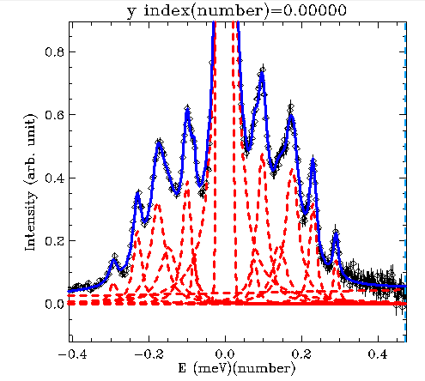
Background
Materials & Method
Preliminary Results
Conclusions
Case 1I: UiO-66 CH₄ rotational tunnelling modes
5
Peak No. | Avg Area | Ratio
1 | 0.0029605 | 1.0000
2 | 0.0100795 | 3.6529
3 | 0.025015 | 8.3910
4 | 0.014495 | 6.0513
5 | 0.003705 | 6.4205
6 | 0.003795 | 1.2946
6
3
4
2
1
Expected intensity ratio - 10:5:2:8:4
UiO-66: h = -30.5 µeV; h₄ = -2.6 µeV
MOF -5: h= -30.27µeV; h₄= -7.83µeV
h = -30.5 μeV; h4 = -2.6 μeV
Title: Probing the Dynamics of Methane in Metal-Organic Frameworks by Disk Chopper Spectrometer
Notes:
SO42-: 2-3mg/L, Mg 700 mg/L; Na 11mg/L
One durability issue AAM may face as a building material is sulfate attack, since sulfate attack is a major durability issue for OPC concrete structures. For the OPC-based materials, sulfate attack occurs when sulfate-bearing chemicals penetrate into the material through the porous network and react with the chemical phases in OPC, leading to severe damage to the material. Under sulfate attack, four major degradation reactions may occur. Two of them involves the sulfate ions taking out Ca, Al from the different chemical phases in OPC to form expansive gypsum and ettringite, which can cause the material to crack. When exposed to MgSO4, the Mg ions may transform the C-S-H gel to a M-S-H gel which has lower cohesive strength. Also, under sulfate attack, especially for MgSO4 and H2SO4, the ph of the system will decrease. The decrease of ph can not only destabilize the chemical phases in OPC but also accelerate the corrosion of steel rebar embedded.
Due to these degradation actions, sulfate attack can cause severe damage to concrete structures. The risk of sulfate attack is real for concrete structure in coastal area since seawater is abundant with Na2SO4 and MgSO4. In places where sulfate bearing soils are presented, sulfate-bearing chemicals can be dissolved in groundwater and cause severe damage to the concrete foundations.
In AAMs, there are also abundant Al and Ca, a nature question one may ask is how does the Al and Ca-containing phases in AAM would interact with these sulfate-bearing chemicals and how does these interaction impact the durability of AAMs. In my phd, I hope to contribute to answering these questions.
Q: how cracks are formed? Crystallization pressure.
Concentration of sulfate ions in sea water and ground water

Slide 14
Background
Materials & Method
Preliminary Results
Conclusions
DCS allows for selectivity over a wide range of energies (µeV-meV)
DCS is powerful tool to probe CH₄ dynamics in porous metal-organic framework.
UiO-66 is more disordered than MOF-5 but similar rotational barriers.
The results can be used to test DFT to improve the theory.
The results can help improve methane storage material development.
h = -30.5 μeV; h4 = -2.6 μeV
Title: Probing the Dynamics of Methane in Metal-Organic Frameworks by Disk Chopper Spectrometer
Notes:
SO42-: 2-3mg/L, Mg 700 mg/L; Na 11mg/L
One durability issue AAM may face as a building material is sulfate attack, since sulfate attack is a major durability issue for OPC concrete structures. For the OPC-based materials, sulfate attack occurs when sulfate-bearing chemicals penetrate into the material through the porous network and react with the chemical phases in OPC, leading to severe damage to the material. Under sulfate attack, four major degradation reactions may occur. Two of them involves the sulfate ions taking out Ca, Al from the different chemical phases in OPC to form expansive gypsum and ettringite, which can cause the material to crack. When exposed to MgSO4, the Mg ions may transform the C-S-H gel to a M-S-H gel which has lower cohesive strength. Also, under sulfate attack, especially for MgSO4 and H2SO4, the ph of the system will decrease. The decrease of ph can not only destabilize the chemical phases in OPC but also accelerate the corrosion of steel rebar embedded.
Due to these degradation actions, sulfate attack can cause severe damage to concrete structures. The risk of sulfate attack is real for concrete structure in coastal area since seawater is abundant with Na2SO4 and MgSO4. In places where sulfate bearing soils are presented, sulfate-bearing chemicals can be dissolved in groundwater and cause severe damage to the concrete foundations.
In AAMs, there are also abundant Al and Ca, a nature question one may ask is how does the Al and Ca-containing phases in AAM would interact with these sulfate-bearing chemicals and how does these interaction impact the durability of AAMs. In my phd, I hope to contribute to answering these questions.
Q: how cracks are formed? Crystallization pressure.
Concentration of sulfate ions in sea water and ground water

Slide 15
Acknowledgments
Summer school organizers
HFBS, DCS and MACS beamline scientists
Guest lecturers
NCNR staff
Group 3 team members
Notes:
Therefore, the research questions I want to ask is 1. how sulfate attack changes the chemistry and and atomic structure of AAMs and 2 how sulfate attack change the pore structure and transport properties of AAMs

